Slide 1
Source control
Source control (or version control) is the practice of tracking and managing changes to code. Source control management (SCM) systems provide a running history of code development and help to resolve conflicts when merging contributions from multiple sources.

Slide 2
Need
Wikipedia defines Source control as "Revision control is the management of multiple revisions of the same unit of information."
Source control allows distributed work in teams of any size, at different locations, while avoiding conflicts in source code changes.
Collaboration
Storing Versions (Properly)
Restoring Previous Versions
Understanding What Happened
Backup

Slide 3
Basic linux commands
Apt-get install
Cd
Ls
Cd ..
Mv
Cp -pr
Mkdir

Slide 4
Git terminolgies
Repos, Staging, Commits
Branch
Feature Branch Workflow
Gitflow Workflow
HEAD
Master
Pull Request
Repository
Tag

Slide 5
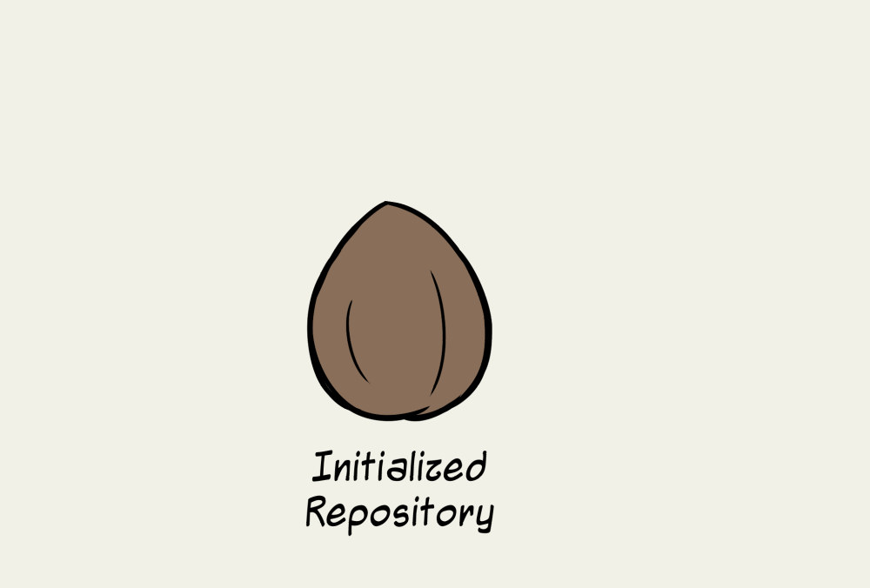
Initialized Repository

Slide 6
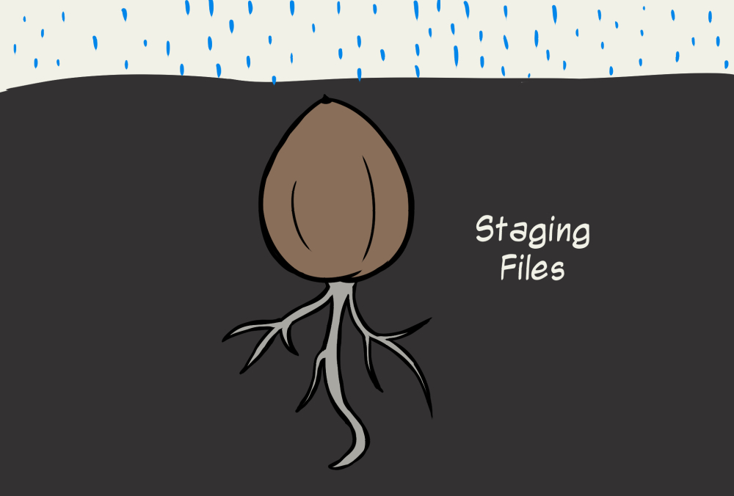
Staging Files

Slide 7
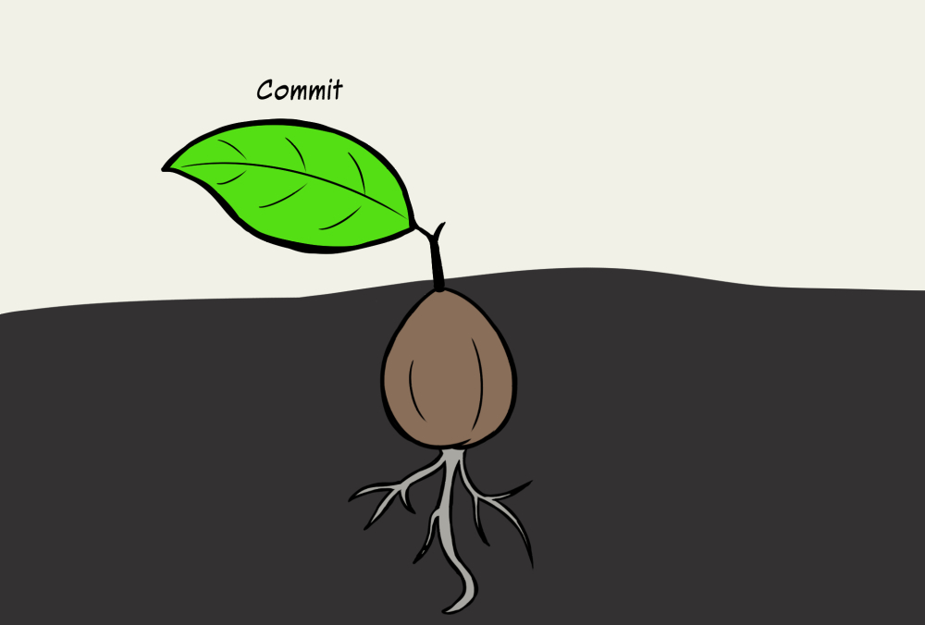
Commit

Slide 8
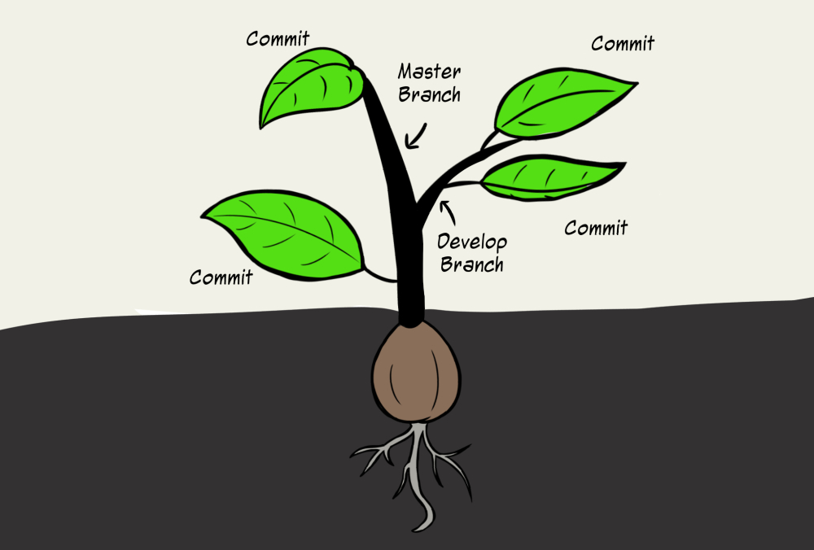
Develop Branch

Slide 9

Work in Sync

Slide 10
Git Installation
apt-get update
Install Git
apt-get install git-core
You may be asked to confirm the download and installation; simply enter y to confirm. It’s that simple, git should be installed and ready to use!
git –version
git config --global user.name "testuser"
git config --global user.email "testuser@example.com"
cat ~/.gitconfig or git config --list

Slide 11
Centralized Workflow
Initialize the central repository
Hosted central repositories
Clone the central repository
Make changes and commit
Push new commits to central repository
Managing conflicts

Slide 12
EXAMPLE
John works on his feature
Mary works on her feature
John publishes his feature - git push origin master
Mary tries to publish her feature
Mary rebases on top of John’s commit(s) - git pull --rebase origin master
Mary resolves a merge conflict
Mary successfully publishes her feature
error: failed to push some refs to '/path/to/repo.git'
hint: Updates were rejected because the tip of your current branch is behind
hint: its remote counterpart. Merge the remote changes (e.g. 'git pull')
hint: before pushing again.
hint: See the 'Note about fast-forwards' in 'git push --help' for details.

Slide 13
Guidelines
Short-lived branches - The longer a branch lives separate from the production branch, the higher the risk for merge conflicts and deployment challenges
Minimize and simplify reverts-It’s important to have a workflow that helps proactively prevent merges that will have to be reverted.
Match a release schedule - A workflow should complement your business’s software development release cycle.

Slide 14
How it works
Start with the master branch
git checkout master
git fetch origin
git reset --hard origin/master
Create a new-branch
git checkout -b new-feature
Update, add, commit, and push changes
git status
git add <some-file>
git commit
Push feature branch to remote
git push -u origin new-feature
Resolve feedback
Merge your pull request

Slide 15
Create Project
Go into the directory containing the project.
Type git init.
Type git add to add all of the relevant files.
You’ll probably want to create a .gitignore file right away, to indicate all of the files you don’t want to track. Use git add .gitignore, too.
Type git commit.
git remote add origin git@github.com:username/new_repo
$ git push -u origin master

Slide 16
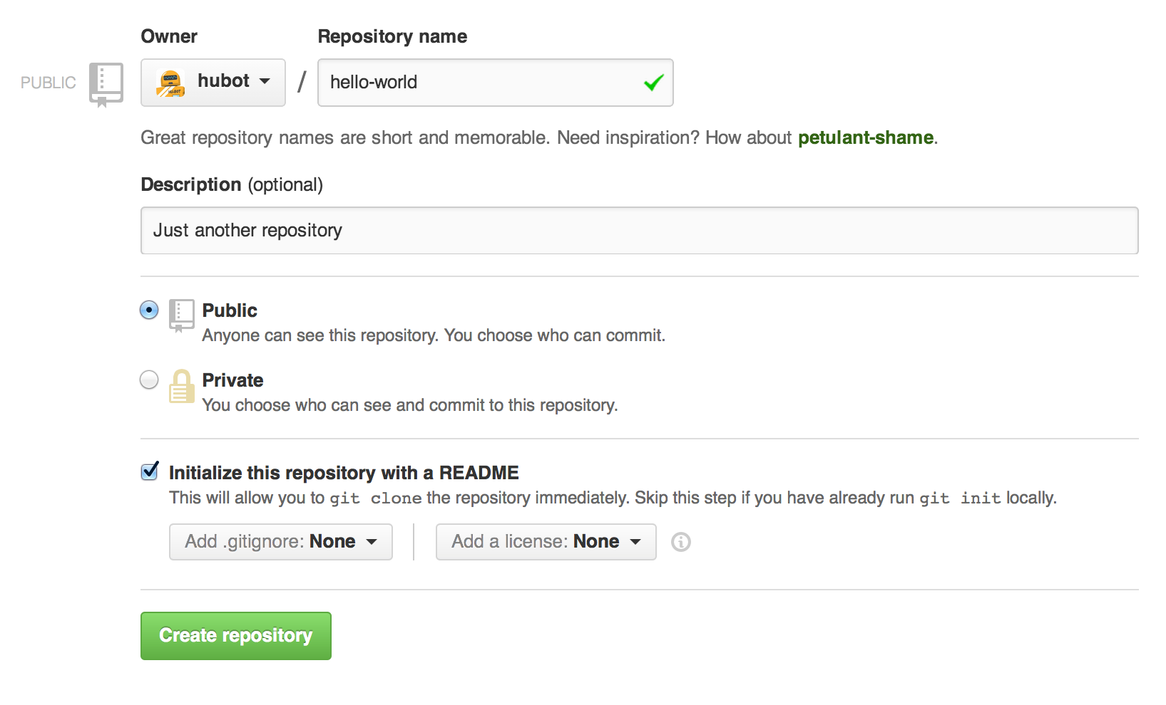
To create a new repository
In the upper right corner, next to your avatar or identicon, click and then select New repository.
Name your repository hello-world.

Slide 17
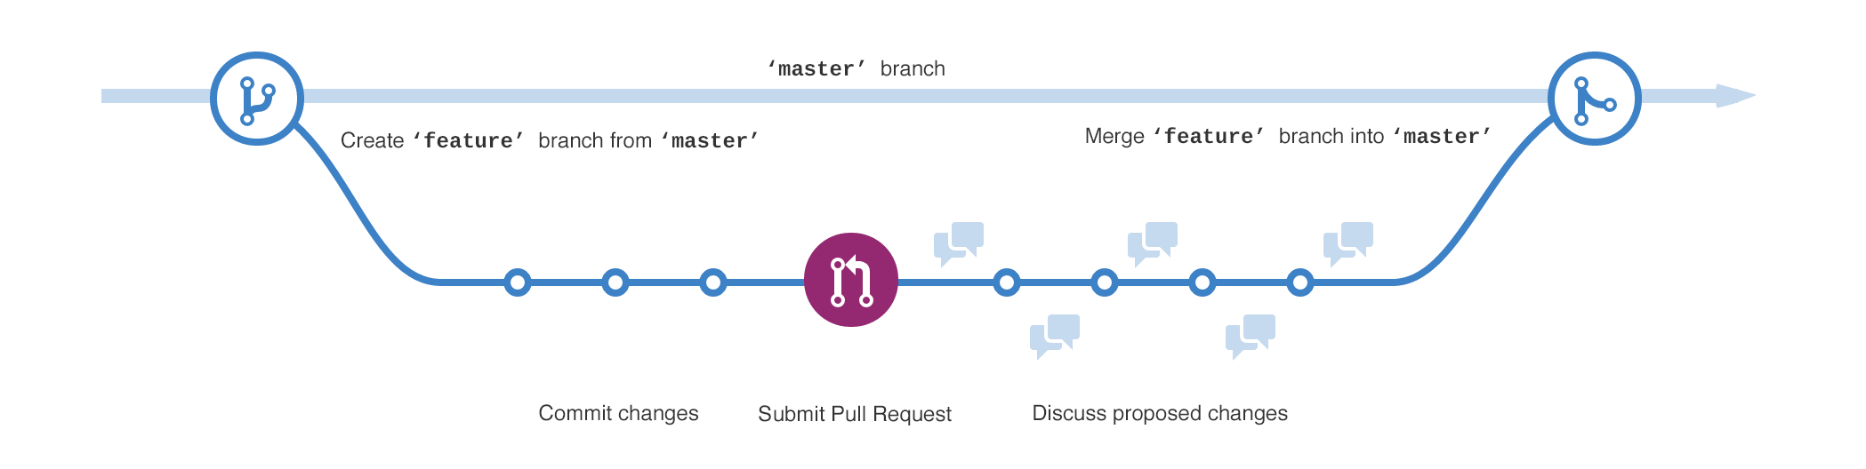
Step 2. Create a Branch
Go to your new repository hello-world.
Click the drop down at the top of the file list that says branch: master.
Type a branch name, readme-edits, into the new branch text box.
Select the blue Create branch box or hit “Enter” on your keyboard.

Slide 18
Make and commit changes
Click the README.md file.
Click the pencil icon in the upper right corner of the file view to edit.
In the editor, write a bit about yourself.
Write a commit message that describes your changes.
Click Commit changes button.

Slide 19
Open a Pull Request
Click the Pull Request tab, then from the Pull Request page, click the green New pull request button.
In the Example Comparisons box, select the branch you made, readme-edits, to compare with master (the original).
Look over your changes in the diffs on the Compare page, make sure they’re what you want to submit.
When you’re satisfied that these are the changes you want to submit, click the big green Create Pull Request button.
Give your pull request a title and write a brief description of your changes. pr-form
When you’re done with your message, click Create pull request!

Slide 20
Step 5. Merge your Pull Request
In this final step, it’s time to bring your changes together – merging your readme-edits branch into the master branch.
Click the green Merge pull request button to merge the changes into master.
Click Confirm merge.
Go ahead and delete the branch, since its changes have been incorporated, with the Delete branch button in the purple box.

Slide 21
Here’s what you accomplished
Create and use a repository
Started and managed a new branch
Changed a file and committed those changes to GitHub as commits
Opened and merged a Pull Request

Slide 22
HISTORY
Git log –full-diff file.txt
git commit –amend --no-edit= to changelast commit message
git rebase -i HEAD~3
Stopped at f7f3f6d... changed my name a bit
You can amend the commit now, with
git commit –amend
Once you’re satisfied with your changes, run
git rebase --continue

Slide 23
Branching
git checkout -b iss53
Switched to a new branch "iss53"
or
git branch iss53
$ git checkout iss53
Vi file.txt
git commit -a -m 'added a new footer [issue 53]'

Slide 24
DELETE A BRANCH
git branch -d hotfix
Deleted branch hotfix (3a0874c).
git checkout iss53

Slide 25
BRANCHING AND MERGING
git checkout -b hotfix
vi index.html
$ git commit -a -m 'fixed the broken email address'
git checkout master
$ git merge hotfix

Slide 26
Working Dir, Staged Area
Working Directory → files in your working directory.
Staging Area (aka cache, index) → a temp area that git add is placed into.
HEAD → A reference to a specific commit (think of it as a variable). Normally, it points to the last commit in local repository. (that is, after you did git commit).

Slide 27
LOCAL AND REMOTE
A local branch is a branch that only you (the local user) can see. It exists only on your local machine.
A remote tracking branch is a local copy of a remote branch. When myNewBranch is pushed to origin using the command above, a remote tracking branch named origin/myNewBranch is created on your machine.
git push -u origin myNewBranch

Slide 28
Branching
Branching, in revision control and software configuration management, is the duplication of an object under revision control (such as a source code file or a directory tree) so that modifications can happen in parallel along both branches. Branches are also known as trees, streams or codelines

Slide 29
Merging
In the most frequent use cases, git merge is used to combine two branches. The following examples in this document will focus on this branch merging pattern. In these scenarios, git merge takes two commit pointers, usually the branch tips, and will find a common base commit between them
git checkout master
Switched to branch 'master'
$ git merge iss53

Slide 30
Steps to add a new file
Add a file and go to directory
git status
git add .
git commit -m "Latest Commit"
git pull
git push

Slide 31
Steps to add a New File in New Repo
Add yourself in the collaborators of the new repo from settings -> Collaborators
Take a clone of the repo using the URL in clone or download option of new Repo
Add or change a file.
Check git status to check your change.
Type git add . Filename and then commit ur file using git commit -m “Message”
Type git pull- You will get a conflict if the file is same and changes have been made else you will get up-to-date.
Make the changes if required again and push the file by
git push
Type username and password. File will be pushed to the New Repository

Slide 32
STASHING
Often, when you’ve been working on part of your project, things are in a messy state and you want to switch branches for a bit to work on something else. The problem is, you don’t want to do a commit of half-done work just so you can get back to this point later. The answer to this issue is the git stash command.
How to get commit ID?
git log -3

Slide 33
Stashing Your Work
git status
$ git stash
$ git status
git stash list
git stash apply
git stash drop stash@{0}

Slide 34
Git stash save
This command is like Git stash. But this command comes with various options.
Git stash with message
git stash save “Your stash message”.
The above command stashes with a message.
Stashing untracked files
You can also stash untracked files.
git stash save -u or git stash save --include-untracked
Git stash list
When you Git stash or Git stash save, Git will actually create a Git commit object with some name and then save it in your repo.
So it means that you can view the list of stashes you made at any time.
git stash list

Slide 35
Git stash apply
This command takes the top most stash in the stack and applies it to the repo. In our case it is stash@{0}
Git stash pop
This command is very similar to stash apply but it deletes the stash from the stack after it is applied.
Git stash show
This command shows the summary of the stash diffs. The above command considers only the latest stash.
Git stash branch <name>
This command creates a new branch with the latest stash, and then deletes the latest stash ( like stash pop).
Git stash clear
This command deletes all the stashes made in the repo. It maybe impossible to revert.
Git stash drop
This command deletes the latest stash from the stack. But use it with caution, it maybe be difficult to revert.
git stash drop stash@{1}

Slide 36
Creating a Branch from a Stash
git stash branch testchanges
Switched to a new branch 'testchanges'
Cleaning your Working Directory
git clean -d -n

Slide 37
Un-applying a Stash
git stash show -p stash@{0} | git apply -R
or git stash show -p | git apply -R
git config --global alias.stash-unapply '!git stash show -p | git apply -R'
$ git stash apply – To apply
$ git stash-unapply
Creating a Branch from a Stash = git stash branch testchanges

Slide 38
Tags
Tags are ref's that point to specific points in Git history. Tagging is generally used to capture a point in history that is used for a marked version release (i.e. v1.0.1). A tag is like a branch that doesn't change. Unlike branches, tags, after being created, have no further history of commits.

Slide 39
Creating a tag
git tag <tagname>
git tag -a v1.4

Slide 40
git merge iss53
Auto-merging index.html
CONFLICT (content): Merge conflict in index.html
Automatic merge failed; fix conflicts and then commit the result.
git status
REMOVE <<<<<<< HEAD AND ======== AND >>>>.
COMMIT AGAIN

Slide 41
Coding Standards and Best Practices
Write comments and documentation
Write readable yet efficient code
Use helper methods
If avoidable, do NOT hard-code!
Write test cases. Don’t forget the edge cases: 0s, empty strings/lists, nulls, etc.
Write readable yet efficient code.Conform to the coding standards of your current project

